Slide 1
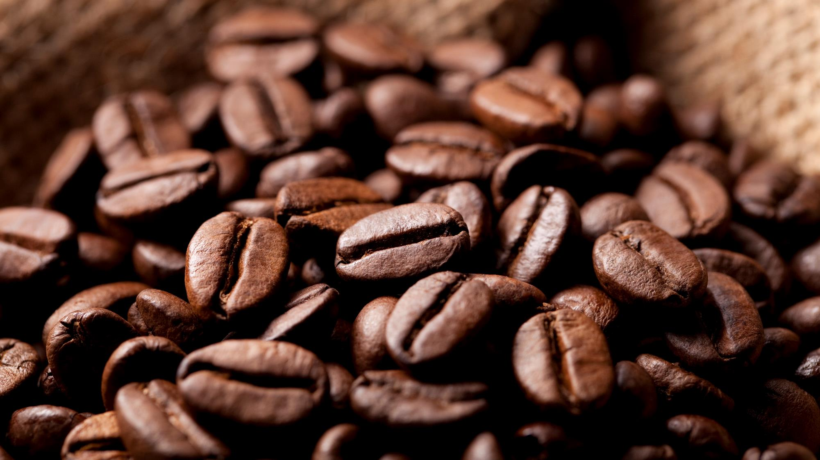
Coffee over time
Is your daily coffee cup leaving you broke?

Slide 2
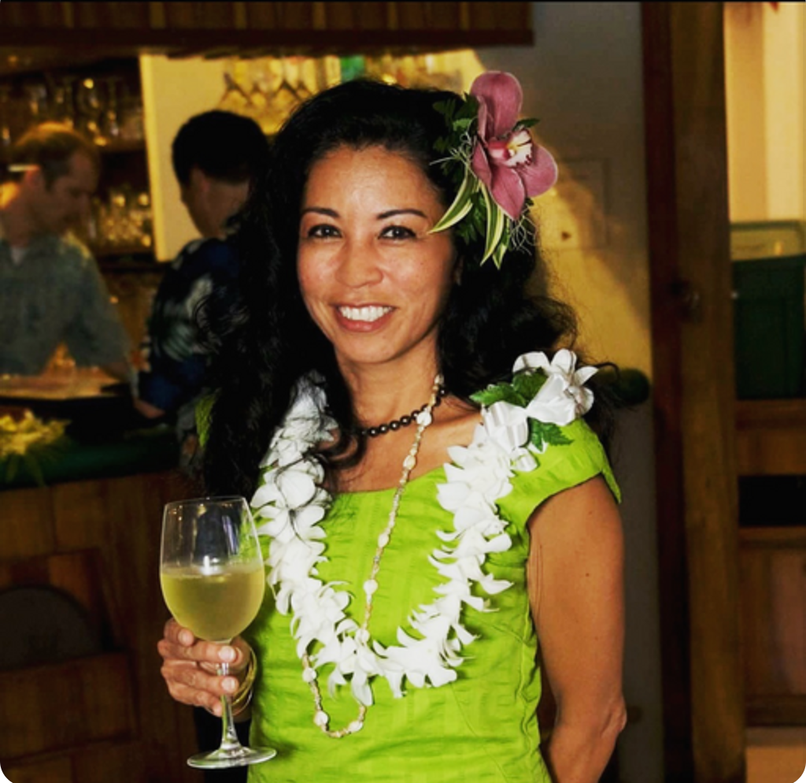



FINAL 3 Brewers
CHELSEA MILLER
GUSTAVO HERNANDEZ
HENRI TUDELA

Slide 3
Chelsea Miller
Experienced in Customer Service and Healthcare, Data Science
Work Experience
(2008 – Present) Food Service/Bar industry, with experience in office work and healthcare.
(May 2021- Present) Howl at the Moon Kansas City
Education
(January 2011- July 2011) CAN at Parsons Health
(September 2021- July2022) Woz-U Data Science Program

Slide 4
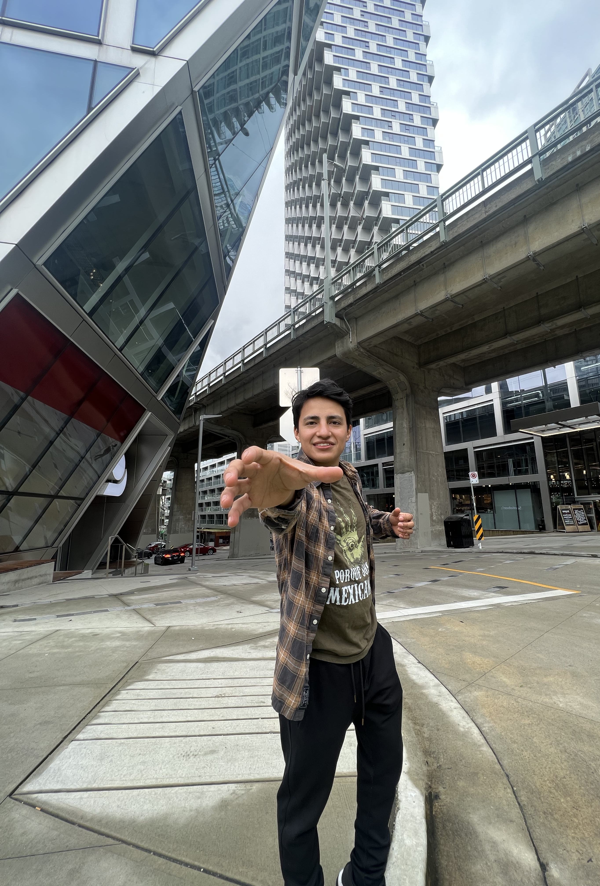
Gustavo A hernandez
My expertise areas are Economics and Mathematics. I love to work with topics that can have interesting results.
Education
(2022 – Present) Evergreen Valley College working in an Associates in Arts in Economics and going towards a 4-year University for a degree in Economics
(2021 – 2022) Southern Careers Institute Inc Powered By Woz-U - Certification in Data Science
(2017) Associates Degree in Accounting & Businesses Management – Mexico
Work Experience
(2021 – Present) Tesla Motors Inc – Production Associate
(2018 -2021) Easy-Pak LLC – Operator III
(2017 – 2018) Inbursa Bank – General Assistant (Mexico)

Slide 5
Henrietta (Henri) tudela
I spent the last 19 years at a Luxury Retailer which I held a position as the General Manager.
Due to the pandemic and the world changing, I wanted to enter the Technology Field in hopes of transitioning and transferring my management skills into a new career.
(August 2021- July 2022) WOZ-U Data Science Course

Slide 6
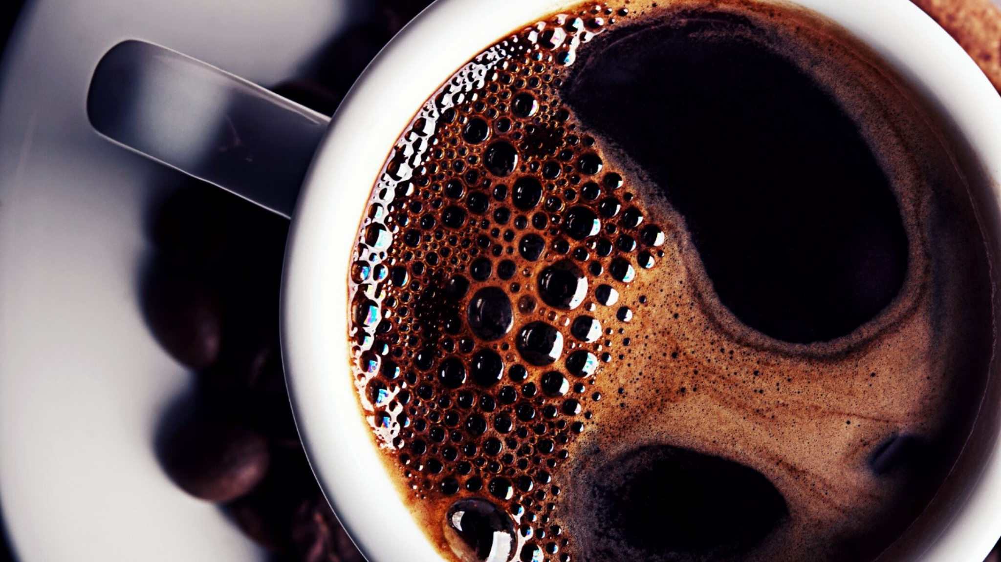
COFFEE
WHO DOES NOT LIKE COFFEE?

Slide 7
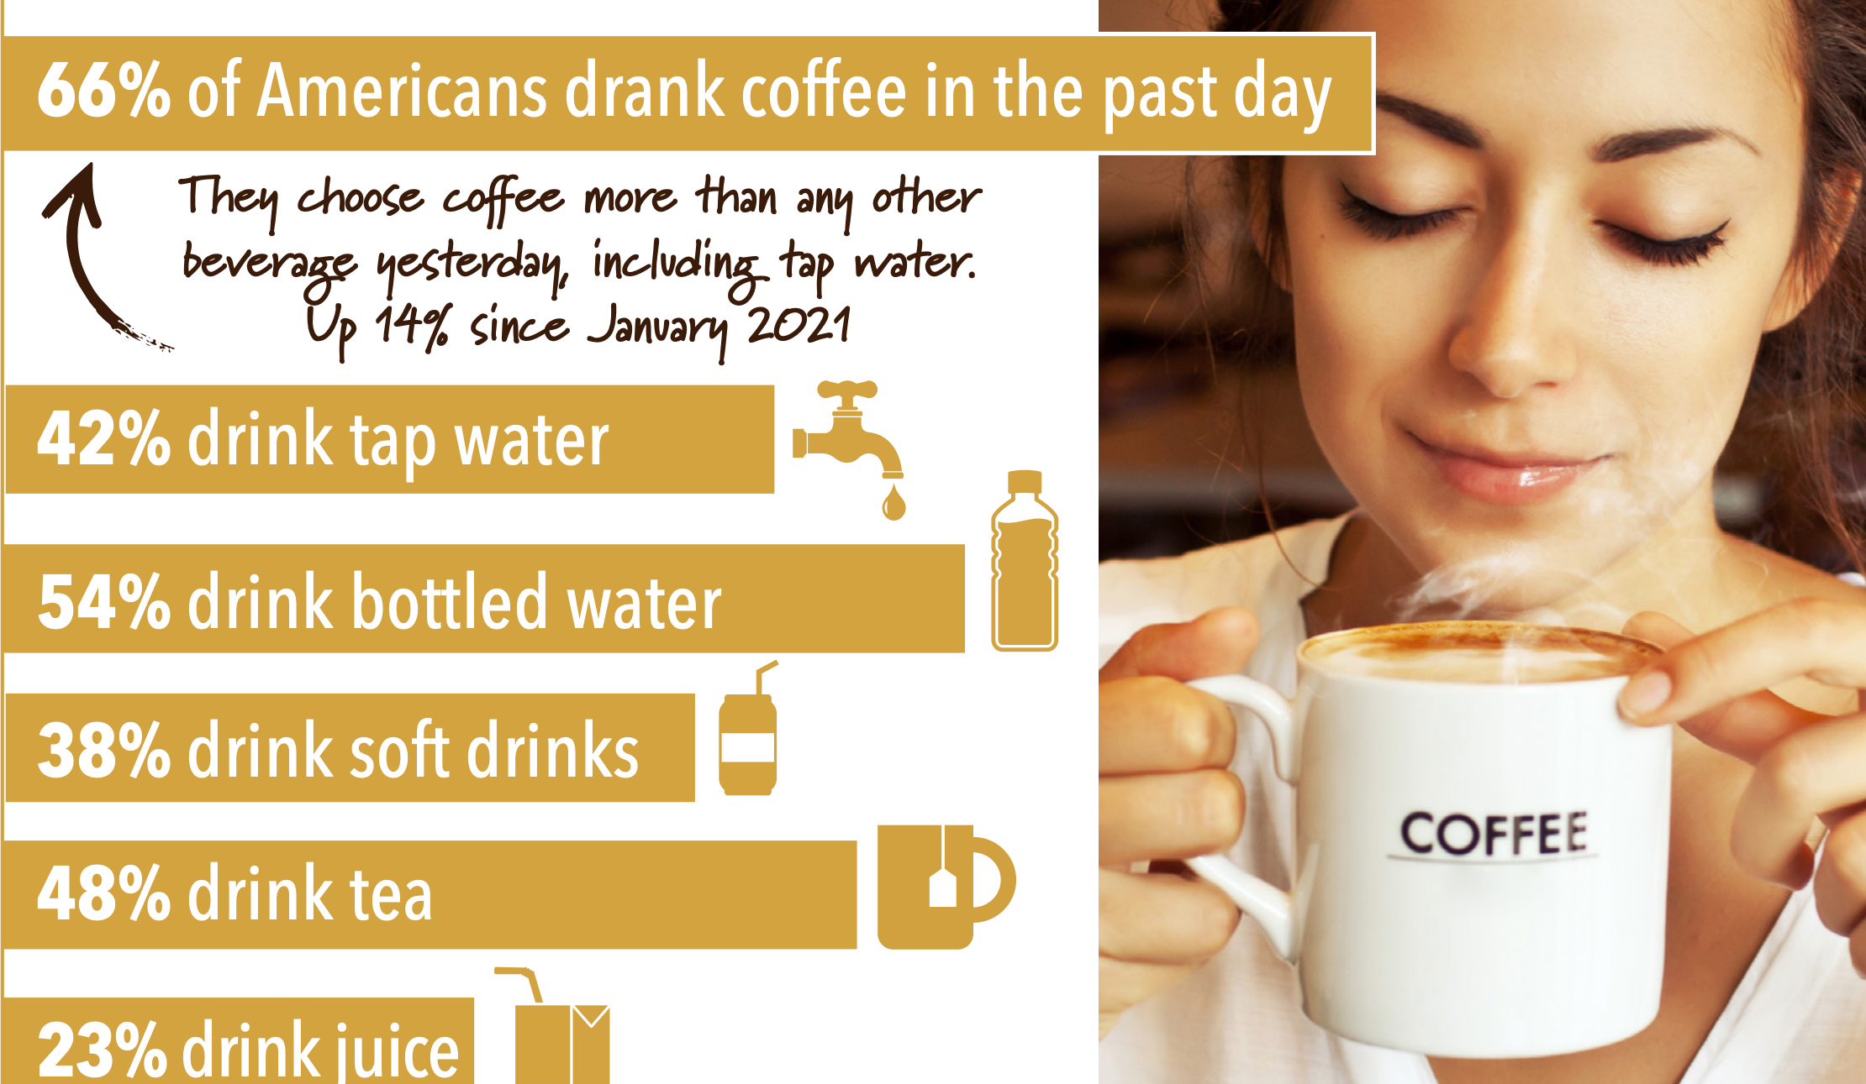
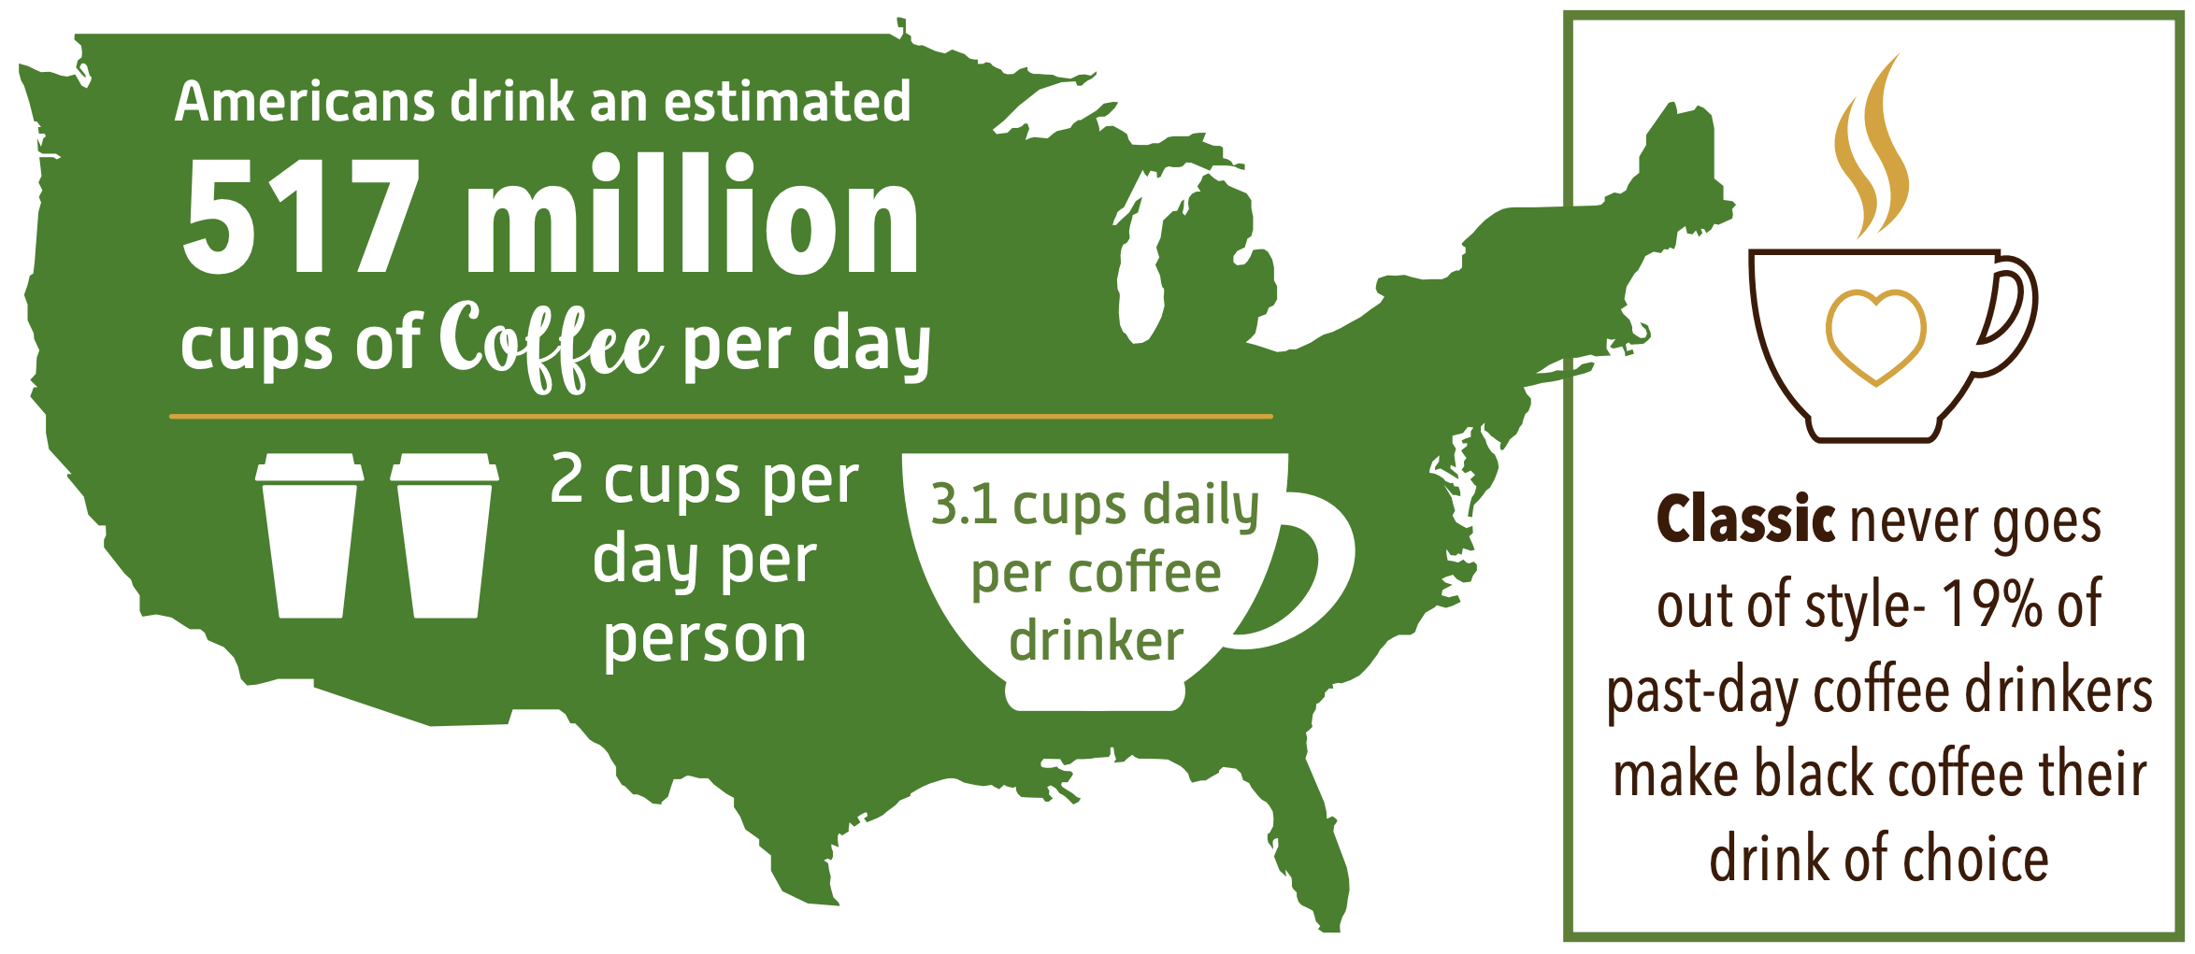
Coffee has been the world’s favorite drink the two last decades. The US has a population of 331,449,281 according to the 2020 CENSUS. Of the 66% of the population that drink coffee, most enjoy at least 2 cups every day.
https://www.ncausa.org/Research-Trends/Market-Research/NCDT
https://www.census.gov/library/visualizations/interactive/2020-population-and-housing-state-data.html

Slide 8
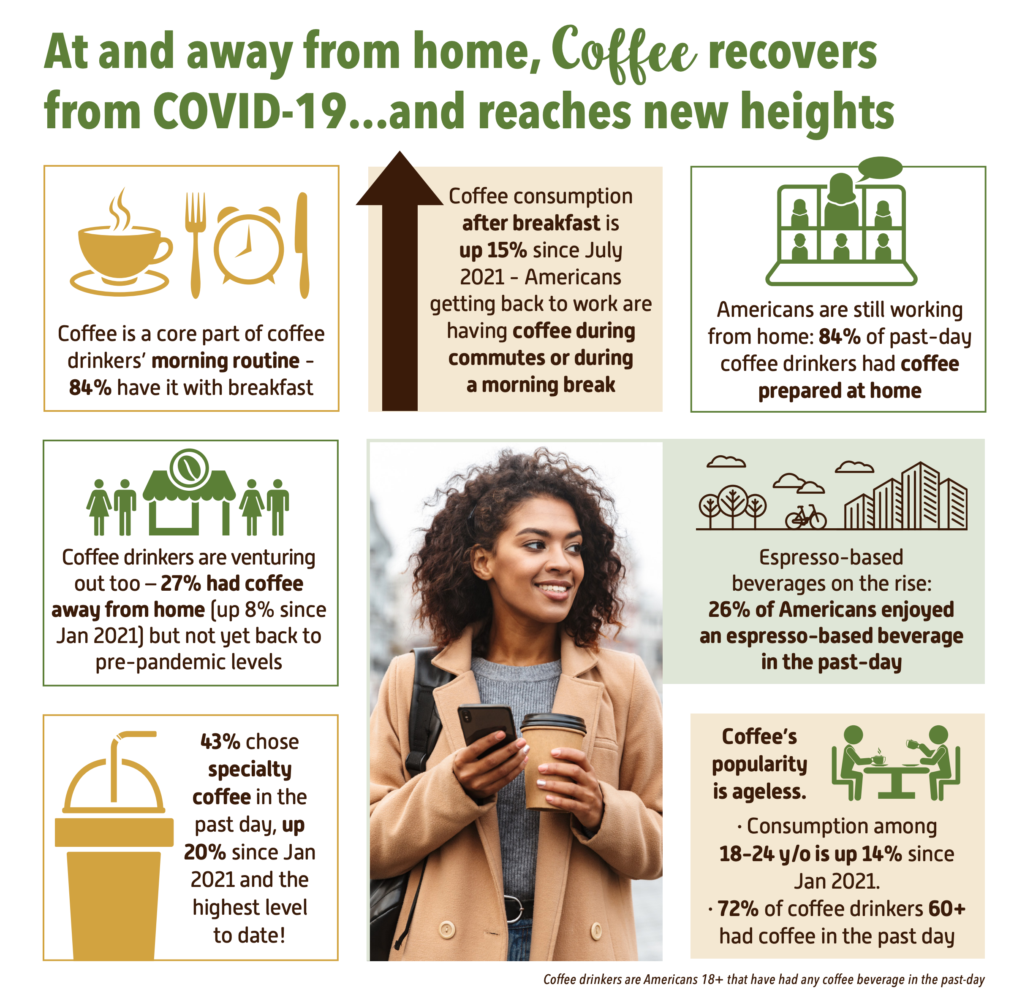

Did coffee defeat covid-19?
Coffee price in the Stock Market
Price per sack of 60kg
December 2020 $121.5 – February 2022 $246.2
Prices Increased by 203%

Slide 9
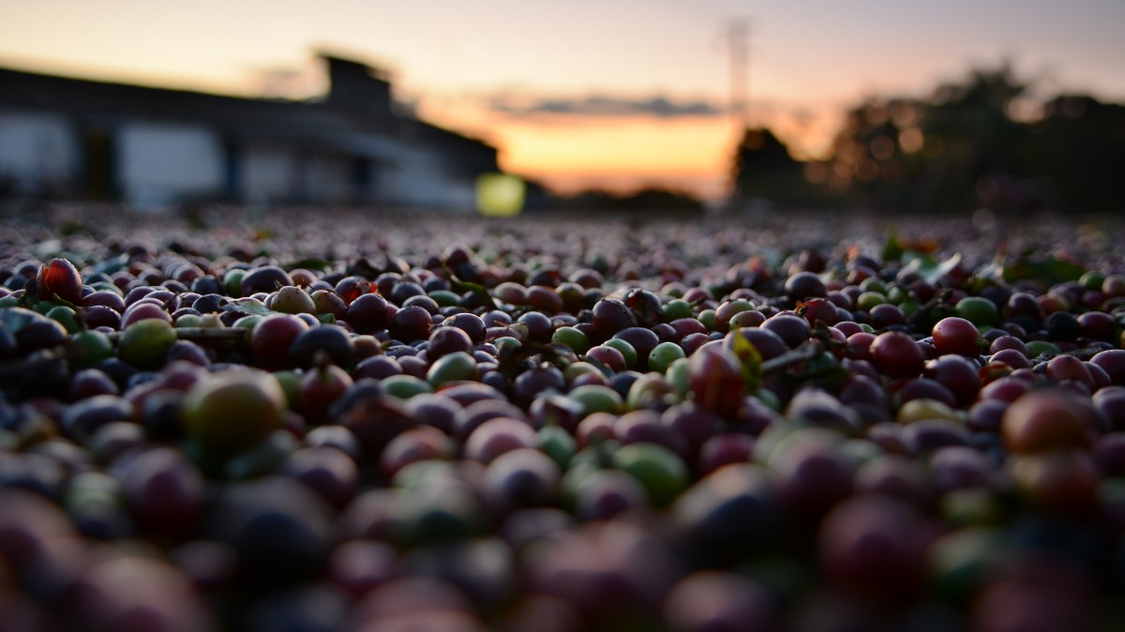
2011

Slide 10
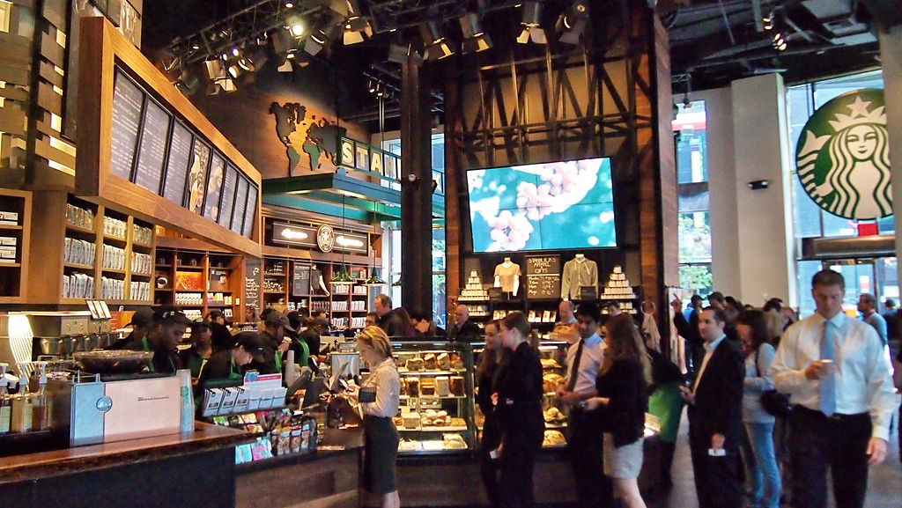
THE ONE-CENT STORM STARBUCKS MADE NEW YORKERS COUNT PENNIES IN 2011
In 2011 Starbucks increased the price of their tall coffee from $1.89 to $2.01 including taxes.
This event made New Yorkers change their lifestyles.
https://www.nytimes.com/2012/01/15/your-money/a-starbucks-price-increase-to-a-not-so-round-final-number.html
This Photo by Unknown Author is licensed under CC BY-SA

Slide 11

VALHALLA, It’s raining!
Heavy rainy days were happening in the largest coffee producing counties, such as Colombia, Brazil and Mexico.
Demand increase in Asia caused an extensive period of a coffee shortage until late 2013, due to the bad

Slide 12

2020
This Photo by Unknown Author is licensed under CC BY-ND

Slide 13
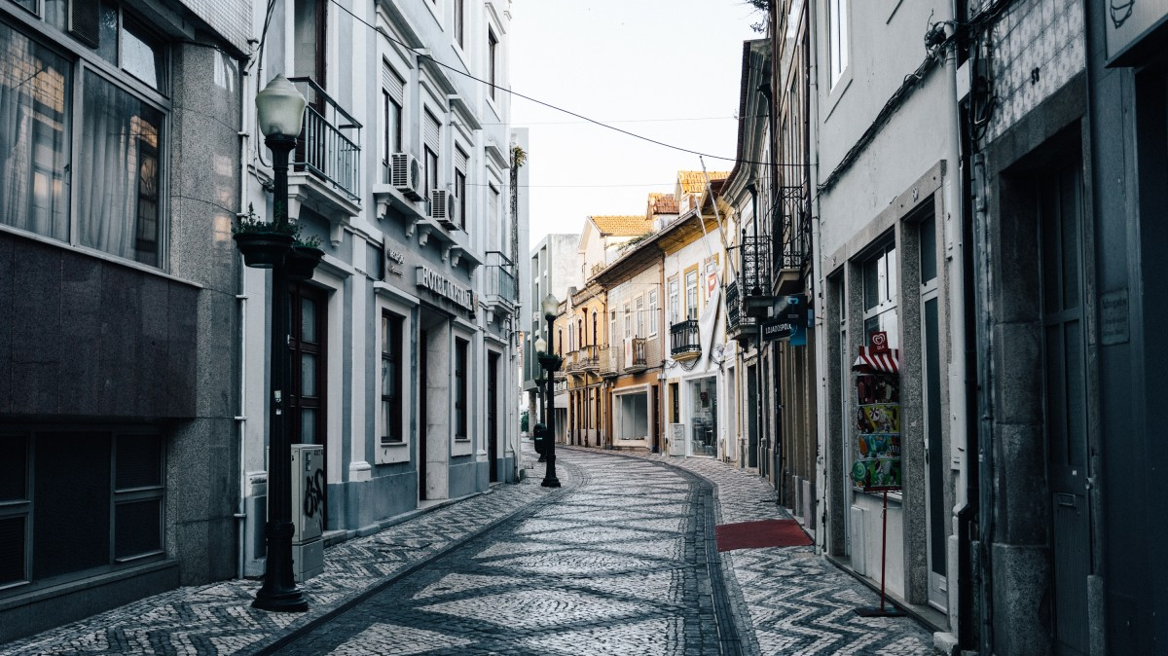
LOCKDOWN
Due to the current pandemic, the economy was severely impacted. Lockdown made many businesses cease production, fired employees and even shut down non-essential businesses.
Price of commodities started to increase, and even toady it has not stopped.

Slide 14
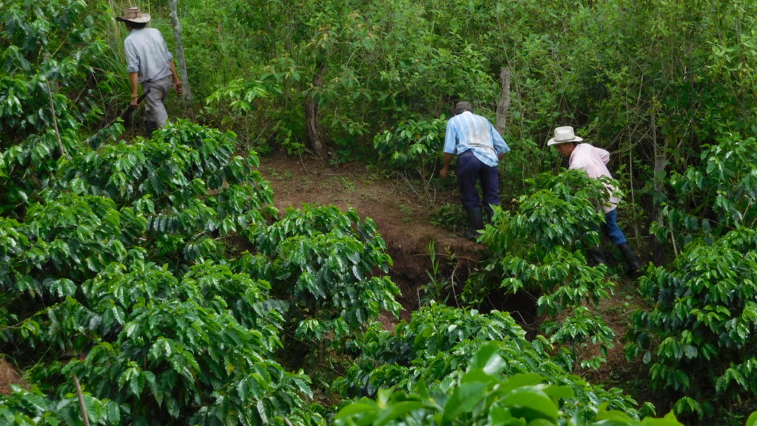
Land Of no coffee
2022 has had problems with the commodity of coffee because of its high demand but there is a shortage of land due to the weather in the producing countries.
This Photo by Unknown Author is licensed under CC BY-NC-ND

Slide 15
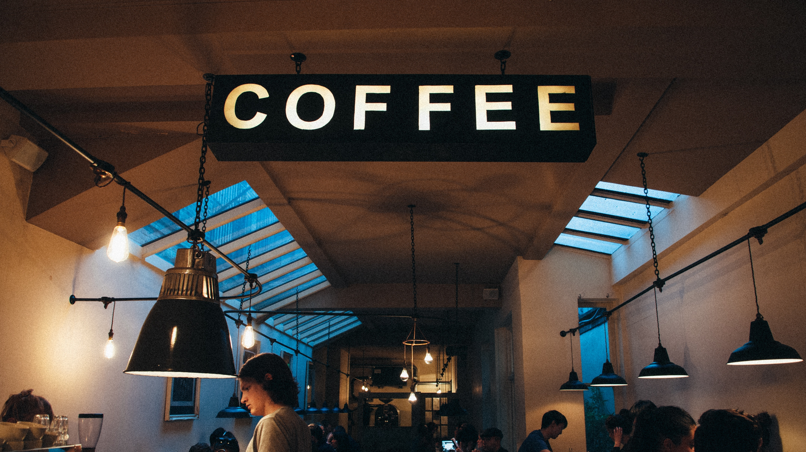
QUESTIONS?

Slide 16
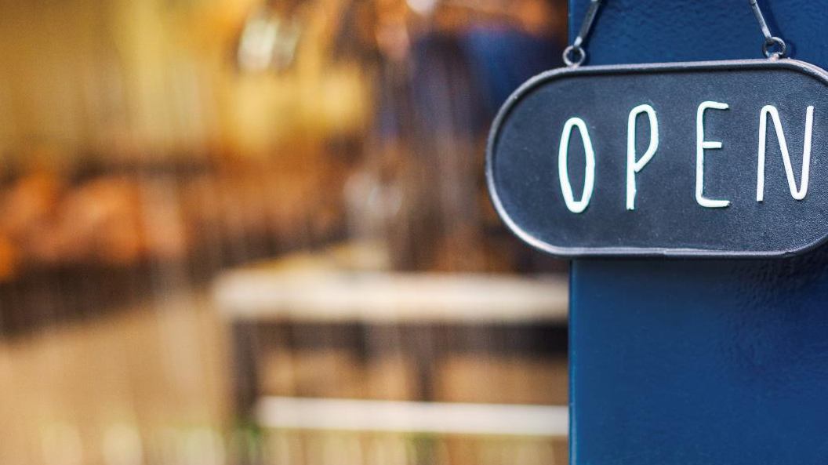
Thank You

